Slide 1
INEES Introduction to EU Education for Secondary Schools

Slide 2
Serbia and EU /EU Programmes 2021-2027/

Slide 3
European Affairs Fund AP Vojvodina was established by the Assembly of the AP of Vojvodina in 2010
Fund’s organizational structure
Sector for EU programms and projects
preparation and implementation of EU funded projects (24 projects with a total budget 25 million euros)
8 projects (cc. 5 million EUR) in implementation
drafting reports and preparing public procurements
educational activities (3 day training course and Specialized academy for PCM)
Antenna of Creative Europe Culture Desk Serbia (2015)
Sector for European cooperation
cooperation with leading European and international institutions
cooperation with Universities, faculties, research centers and other academic institutions
cooperation with local self-governments and national and provincial institutions
Regional representative office of AP Vojvodina in Brussels

Slide 4
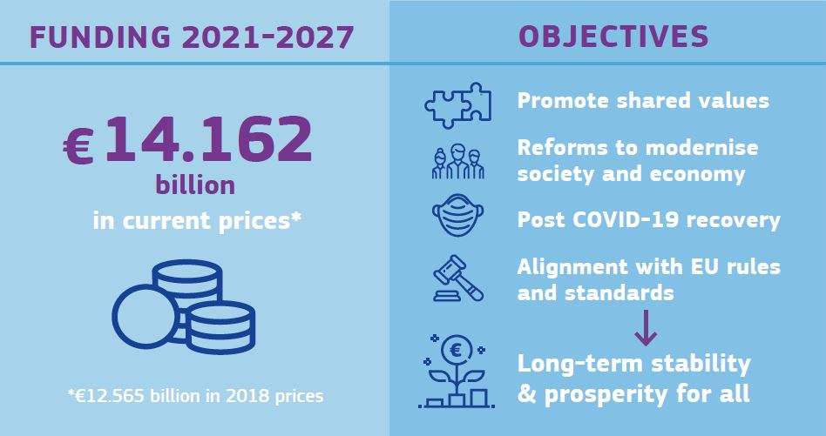
The EU is by far the biggest donor to Serbia with more than €3.6 billion (3.688) in grants provided over the past 18 years in all fields, ranging from rule of law, public administration reform, social development, environment and agriculture. The EU is also the largest lender to Serbia, with more than €4.3 billion worth of loan agreements through European Investment Bank – EIB, European Bank for Reconstruction and Development – EBRD, Council of Europe Development Bank. KEY INSTRUMENT: IPA focused on candidate and potential candidates countries
Serbia and EU

Slide 5
EU PROGRAMme PERIOD 2021-2027
INTERREG Cross-border Cooperation Programmes
EU Programmes
INTERREG IPA Cross-border Cooperation Programme Hungary-Serbia
Erasmus +
INTERREG IPA Cross-border Cooperation Programme Bulgaria-Serbia
Creative Europe
INTERREG IPA Cross-border Cooperation Programme Romania-Serbia
Europe for citizens
INTERREG IPA Cross-border Cooperation Programme Croatia-Serbia
Horizont 2020
INTERREG IPA Cross-border Cooperation Programme Serbia-Bosnia and Herzegovina
INTERREG IPA Cross-border Cooperation Programme Serbia-Montenegro
COSME
Danube transnational programme
The Employment and Social Innovation(EaSi)
Adriatic-Ionian transnational programme (ADRION)
European Health Programme

Slide 6
EU PROGRAMme PERIOD 2021-2027
Programs in which youth from Serbia can participate
Various EU Programmes have direct or indirect focus on young people. It is necessary for governments and people in positions of power to listen the needs of young people in order to tackle all challenges in best way possible.
ERASMUS+
HORIZON EUROPE
DIGITAL EUROPE
CITIZENS, EQUALITY, RIGHTS AND VALUES
CREATIVE EUROPE
6

Slide 7
ERASMUS+
Education, training, youth and sport
Priorities:
Inclusion and diversity
Digital transformation
Environment and the fight against climate change
Participation in democratic life
Youth exchanges allow groups of young people from different countries to meet, live together and work on shared projects.
7

Slide 8
HORIZON EUROPE
Research and innovation in developing, supporting and implementing EU policies
Pillars:
I - Excellent Science
II - Global Challenges and European Industrial Competitiveness
III - Innovative Europe
Horizon Young Observer
As part of the European Year of Youth, master students in the EU are invited to become “Young Observers” in Horizon Europe proposal evaluations.

Slide 9
CITIZENS, EQUALITY, RIGHTS AND VALUES
Designed to bridge the gap between digital technology research and market deployment
Specific objectives:
Protect and promote Union values
Promote equality, rights and gender equality
Promote citizens' engagement and participation
Prevent and combat gender-based violence and violence against children
Young people as active citizens undoubtedly represent the advantage of every society. It is noticeable that young people are increasingly interested in getting involved in their communities and want to participate in decision-making processes
9

Slide 10
CREATIVE EUROPE
providing support to the cultural and audiovisual sectors
Main objectives:
Safeguard, develop and promote European cultural and linguistic diversity and heritage
Increase the competitiveness and economic potential of the cultural and creative sectors, in particular the audiovisual sector
Strands:
CULTURE
MEDIA
CROSS-SECTORAL
10

Slide 11
EU Youth Strategy 2019-2027
Priorities:
Engage - participation of young people in the life of the EU
Connect - connecting young people in the EU- the strategy also recognizes co-operation with non-EU countries, including Republic of Serbia
Empower - as a catalyst for the empowerment of young people across Europe who are facing different challenges
Permanent Expert Team on EU Youth Dialogue
established in May 2021
The Republic of Serbia is the first country outside of the European Union that has established a national institutional mechanism for harmonization of youth policy in Europe
11

Slide 12
THANK YOU
“For me, Europe is home. For my parents, Europe was peace. For my generation, Europe is freedom and role of law. And for my children, Europe is future and open-mindedness. This is what I’m fighting for. Long live Europe! “
Ursula von der Leyen
Mina Radmilović Pjevac
021/310 20 82
radmilovic.pjevac@vojvodinahouse.eu
www.vojvodinahouse.eu

